Slide 1


Java ee
(ADVANCE JAVA)
Lecture-22

Slide 2
Today’s Agenda
Session Tracking Using Session API
The HttpSession Interface
Working Of HttpSession
Methods Of HttpSession

Slide 3
SESSION TRACKING USING API
All the session tracking method we studied till now were totally based on browser .
However java has provided us another mechanism of session tracking which we can use at the server end.
This mechanism is implemented using a technique called Http Sessions.

Slide 4
SESSION TRACKING USING API
In Http Session mechanism , as soon as a user visits our page , the container creates an object of a special interface called HttpSession and also associates the current user with that session object.

Slide 5
SESSION TRACKING USING API
Now whenever that user revisits our website then the server picks up the session object of that user from a pool of session objects and makes it available to our application .
Thus , our code can easily identify the user and its data .

Slide 6
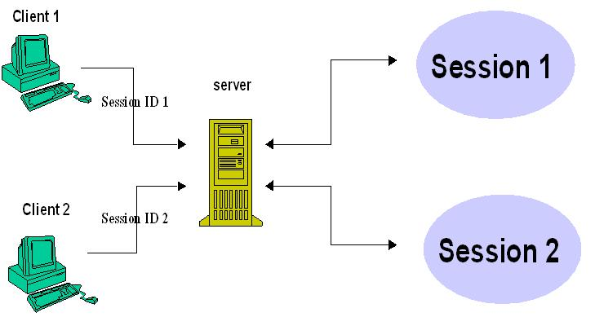
SESSION TRACKING USING API

Slide 7
HOW TOMCAT IS ABLE TO RECOGNIZE WHICH SESSION OBJECT BELONGS TO WHICH USER ?
On creating session object tomcat also generates a unique id which is an alphanumeric string called jsession id and it stores this id in the session object as well as in a cookie called jsessionid.
Then tomcat transmits this cookie to the browser which browser saves in the client machine.

Slide 8
HOW TOMCAT IS ABLE TO RECOGNIZE WHICH SESSION OBJECT BELONGS TO WHICH USER ?
Now as we know browser always sends back the cookie whenever it revisit the same page .
So when the same user revisits our page the browser will transmit back the cookie and tomcat will:
retrieve the session id from that cookie
pullout the session object from the available session pool
make that object available to our application.

Slide 9
WHAT IS THE PROGRAMMER’S ROLE IN THIS ENTIRE PROCESS ?
As a programmer we just have to take 2 actions:
Get the session object .
Set or get data in the session object.
Rest all the operation like creating the session object , assigning session id to it , storing and retrieving session id from the cookie are responsibilities of server .

Slide 10
HOW DO WE GET THE SESSION OBJECT ?
In order to obtain session object programmer has to call the method getSession() which belongs to HttpServletRequest object and has following prototypes :
public HttpSession getSession( )
public HttpSession getSession(boolean)

Slide 11
HOW DO WE GET THE SESSION OBJECT ?
The first method creates and returns a session if it is not present and if it is present then returns the specific session .
The second method is same as the first one if true is passed, but if false is passed then if the session object is present it would be returned but if it is not present then null is returned.

Slide 12
METHODS OF HTTPSESSION INTERFACE
public boolean isNew( )
This method returns true if the session object has been created just now, otherwise it returns false.
public void setAttribute( String Key , Object value)
This method stores data in the session object in key-value pairs
public Object getAttribute( String Key)
This method retrieves the session data based upon the key
public void removeAttribute( String)
This method removes the attribute from session object whose key is passed as argument

Slide 13
METHODS OF HTTPSESSION INTERFACE
public void setMaxInactiveInterval( int)
This method accepts a time period in seconds and sets
the inactive period for the session object.
So , if between two subsequent request the time delay
crosses the mentioned time then session object would
be automatically destroyed by the server.
Also if the value passed is negative then the object never
gets destroyed.

Slide 14
METHODS OF HTTPSESSION INTERFACE
public int getMaxInactiveInterval( )
This method returns the inactive time period set for the session
object in seconds
public String getId()
This method returns the session id associated with the session
object
public void invalidate()
This method destroys the session object and removes all it’s data
public long getCreationTime()
This method returns the time when the session was created,
measured in milliseconds since midnight January 1, 1970 GMT.

Slide 15
EXERCISE
Write a web application containing the following :
An HTML page for logging in.
A JSP page called members.jsp which opens as soon as the user logs in and welcomes the user with his name.
Make sure that if the user tries to open the page
members.jsp directly the he should get a error
message asking him to login before accessing this
page

Slide 16
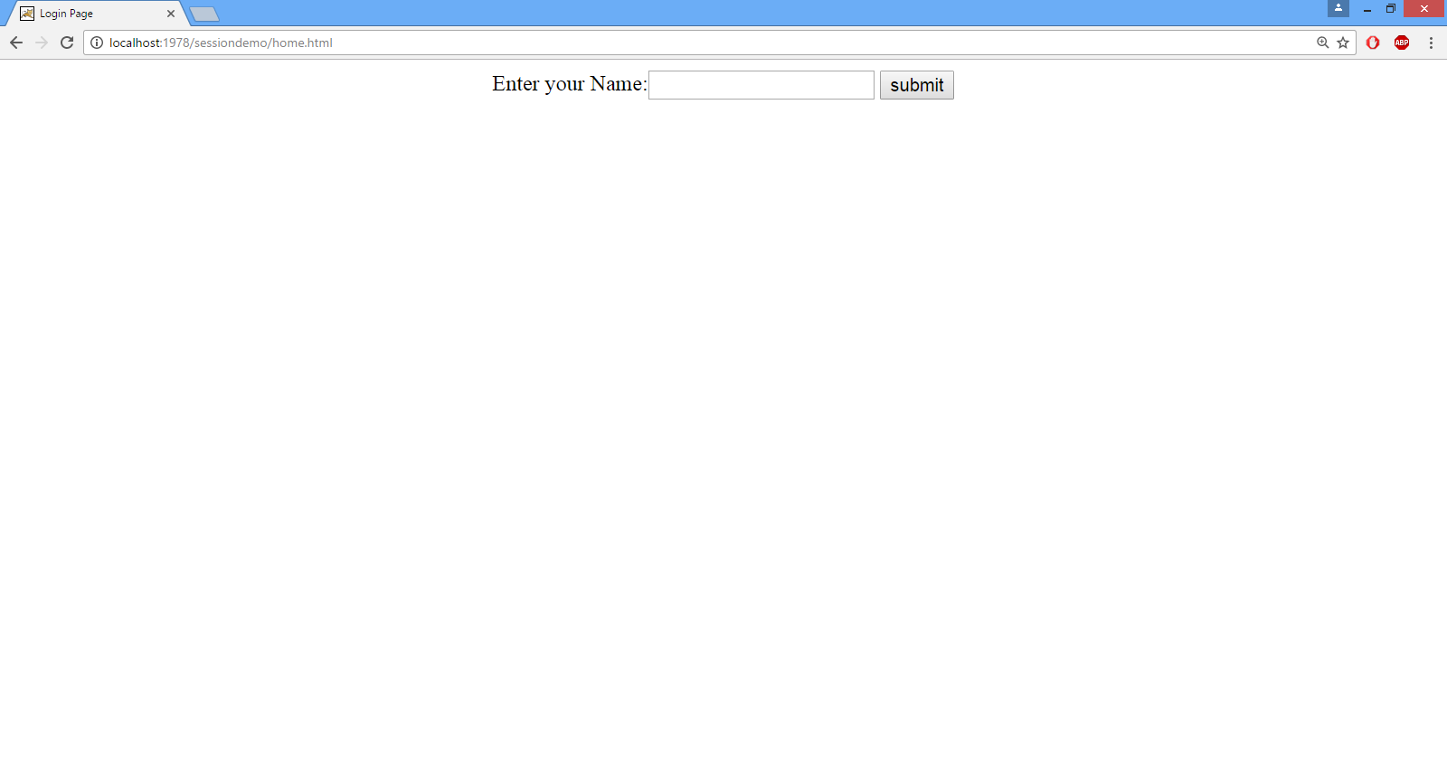
OUTPUT

Slide 17

OUTPUT

Slide 18

OUTPUT

Slide 19
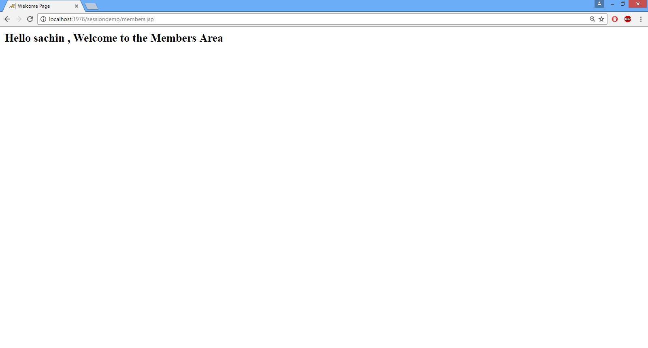
OUTPUT

Slide 20

OUTPUT

Slide 21

End Of Lecture
For any queries mail us @: scalive4u@gmail.com
Call us @ : 0755-4271659, 7879165533
Agenda for Next Lecture:
Session Counter
Session Tracking Without Cookies
Event Handling In Session

